Slide 1


Sales Analysis
Noble Xavier

Slide 2
For companies to become competitive and skyrocket their growth, they need to leverage AI/ML to develop predictive models to forecast sales in the future.
Predictive models attempt at forecasting future sales based on historical data while taking into account seasonality effects, demand, holidays, promotions, and competition.
In this project, you work as a data scientist in the sales department and the sales team provided you with data from 1115 stores.
The objective is to predict future daily sales based on the features.

Slide 3
Id: transaction ID (combination of Store and date)
Store: unique store Id
Sales: sales/day, this is the target variable
Customers: number of customers on a given day
Open: Boolean to say whether a store is open or closed (0 = closed, 1 = open)
Promo: describes if store is running a promo on that day or not

Slide 4
StateHoliday: indicate which state holiday (a = public holiday, b = Easter holiday, c = Christmas, 0 = None)
SchoolHoliday: indicates if the (Store, Date) was affected by the closure of public schools
StoreType: categorical variable to indicate type of store (a, b, c, d)
Assortment: a = basic, b = extra, c = extended
CompetitionDistance (meters): distance to closest competitor store
CompetitionOpenSince [Month/Year]: date when competition was open

Slide 5
Promo2: Promo2 is a continuing and consecutive promotion for some stores (0 = store is not participating, 1 = store is participating)
Promo2Since [Year/Week]: date when store started participating in Promo2
PromoInterval: describes the consecutive intervals Promo2 is started, naming the months
promotion is started new. E.g. "Feb,May,Aug,Nov" means each round starts in February, May, August, November of any given year for that store

Slide 6
STEPS
IMPORT LIBRARIES AND DATASETS
Import train and store data separately
Analyze the data set such as info () , describe () etc

Slide 7
STEPS
Explore Data set : Train
Check for NULL records

Slide 8
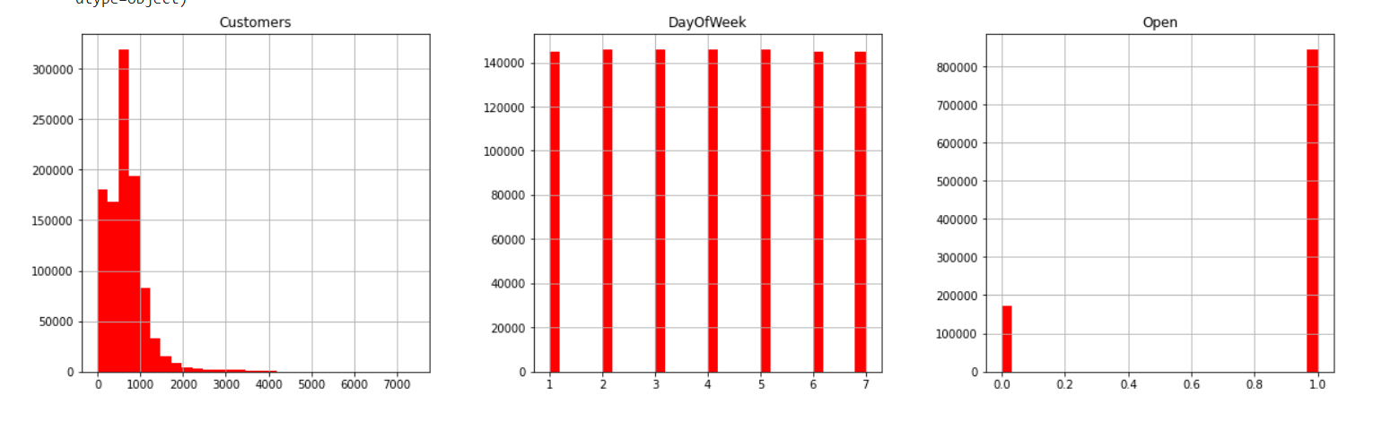
STEPS
Create Histogram to check data

Slide 9
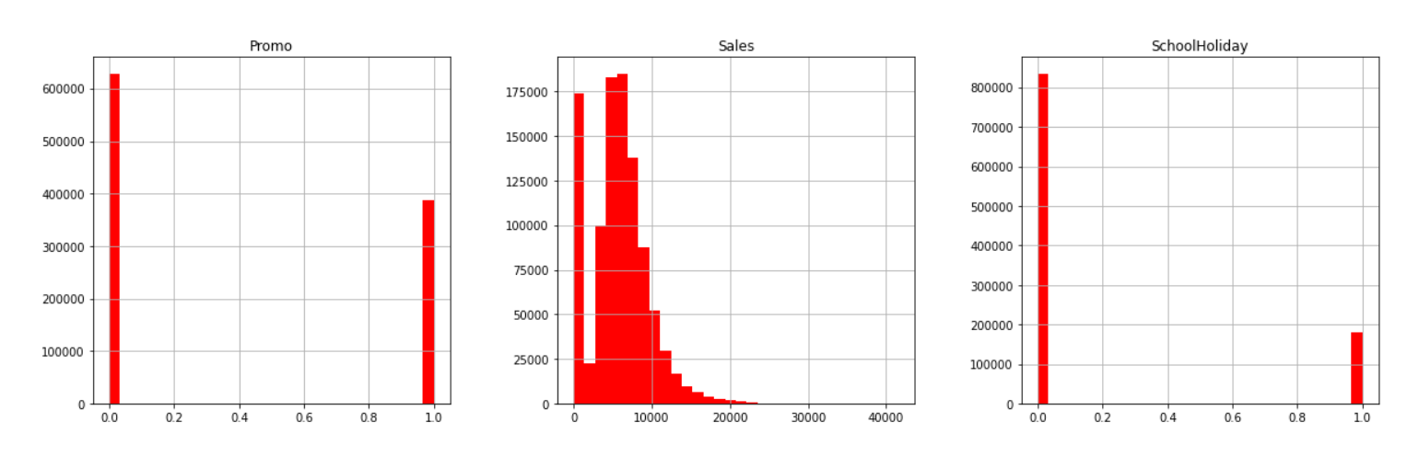

Slide 10
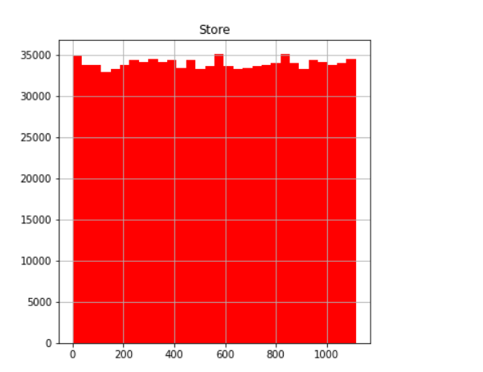

Slide 11
STEPS
Check Maximum number of customers
Count the number of stores that are open and closed
Keep open stores and remove closed stores
Drop the open column since it has no meaning now
Describe the data set Open and check the difference with earlier

Slide 12
STEPS
Data Set : Store.csv
Check for Null values – CompetitionDistance, CompetitionOpenSinceMonth
if 'promo2' is zero, 'promo2SinceWeek', 'Promo2SinceYear', and 'PromoInterval' information is set to zero.
There are 354 rows where 'CompetitionOpenSinceYear' and 'CompetitionOpenSinceMonth' is missing set these values to zeros .
There are 3 rows with 'competitionDistance' values missing, let's fill them up with with average values of the 'CompetitionDistance' column
Check for Null values

Slide 13
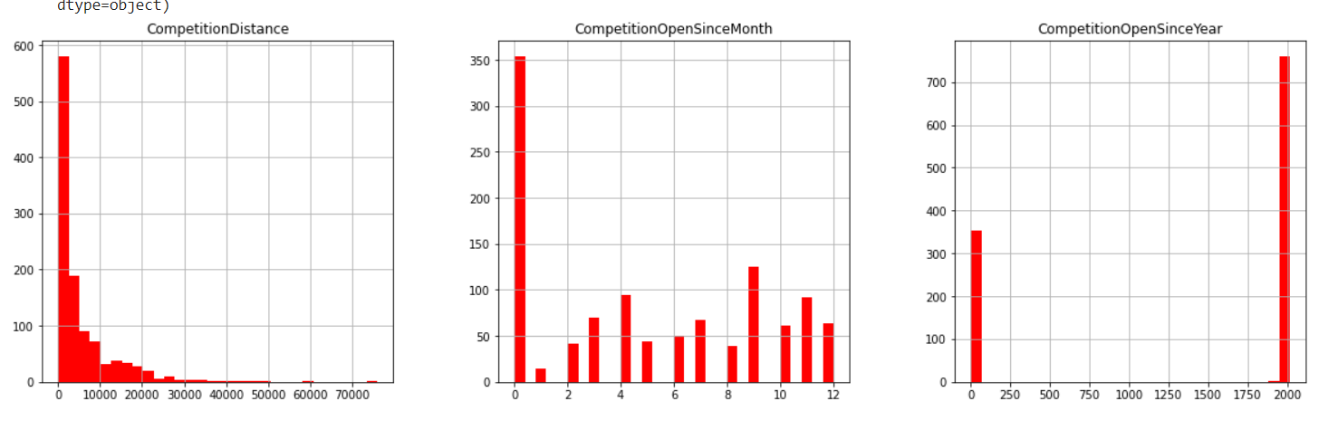
STEPS
Create Histogram to check data

Slide 14
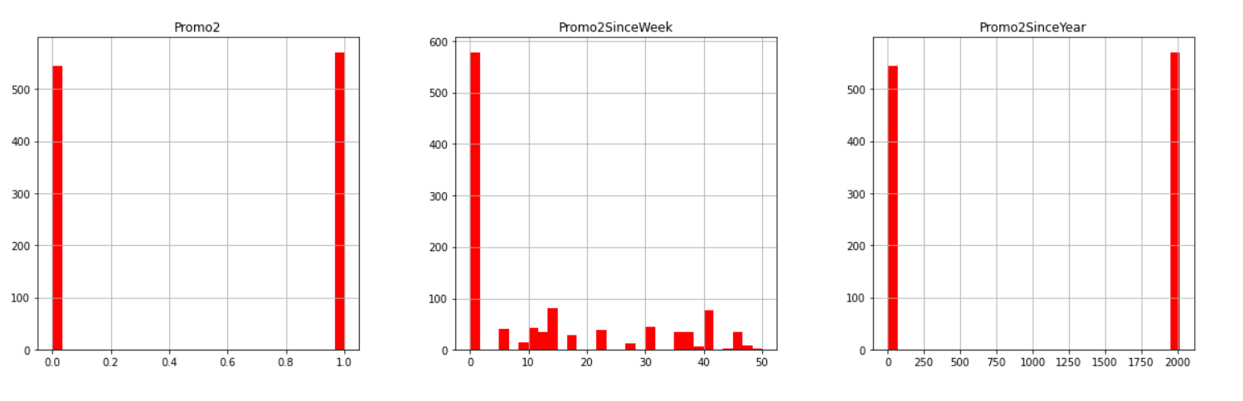

Slide 15
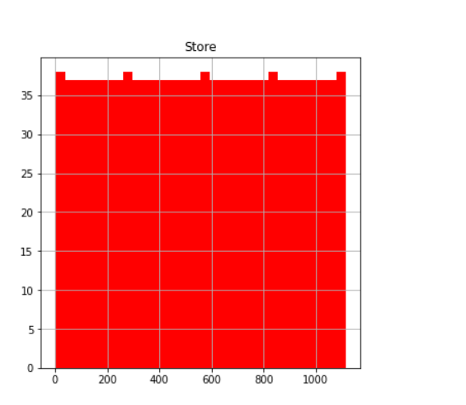

Slide 16
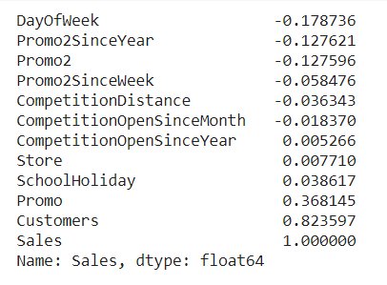
STEPS
Merge both data frames together based on 'store’ sales_train_all_df = pd.merge(sales_train_df, store_info_df, how = 'inner', on = 'Store’)
Create the Co relation with Sales - correlations = sales_train_all_df.corr()['Sales'].sort_values()
correlations
Promo and Customers has good co relation with sales
Create Heat Map

Slide 17
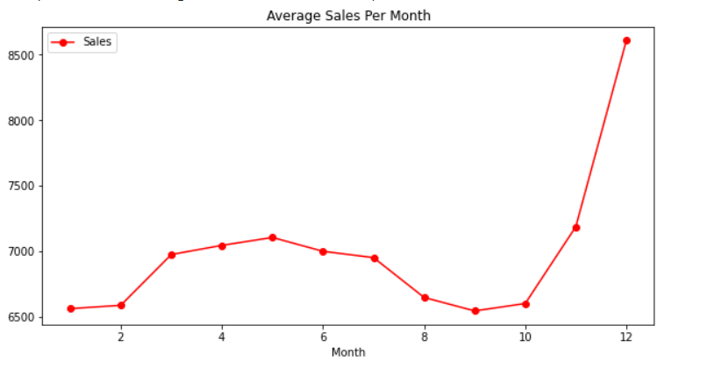
STEPS
Extract Year , Month and Day from the date and create separate columns for Year, Month and Day
Create Average Sales per month (Line Chart)- Group by month

Slide 18
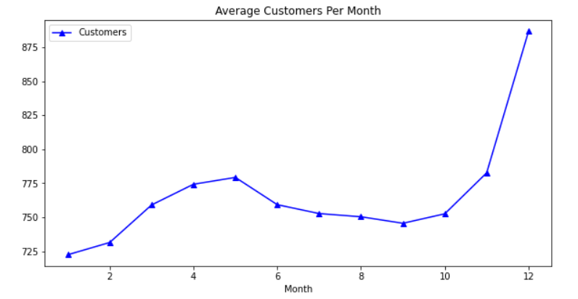
STEPS
Create Average Customer per month (Line Chart)
'groupby' works great by grouping all the data that share the same month column, then obtain the mean of the sales column

Slide 19
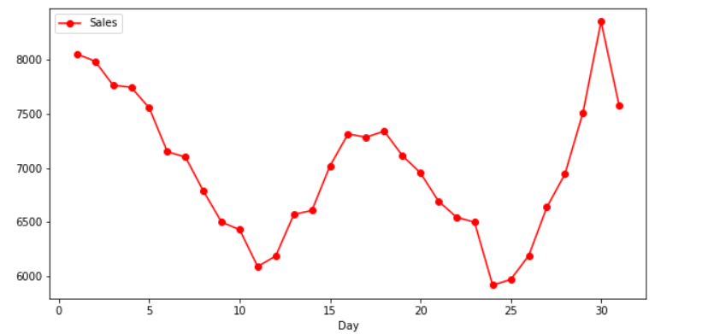
STEPS
Look at the sales and customers per day. Minimum number of customers are generally around the 24th of the month. Most customers and sales are around 30th and 1st of the month

Slide 20
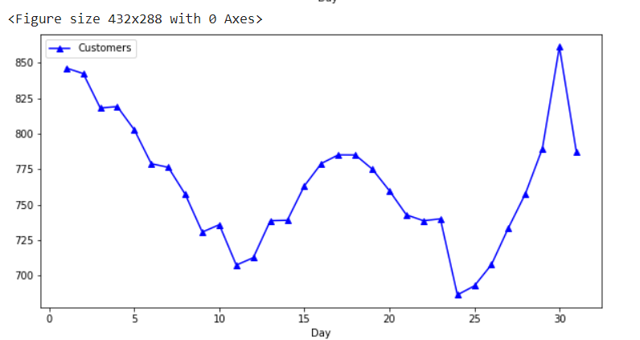
STEPS

Slide 21
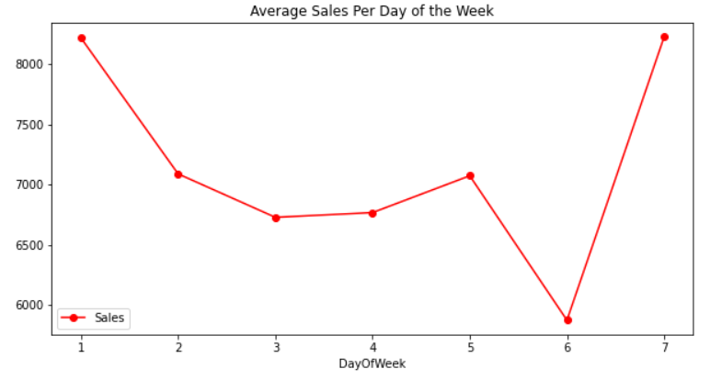
STEPS
Repeat the same for Week

Slide 22
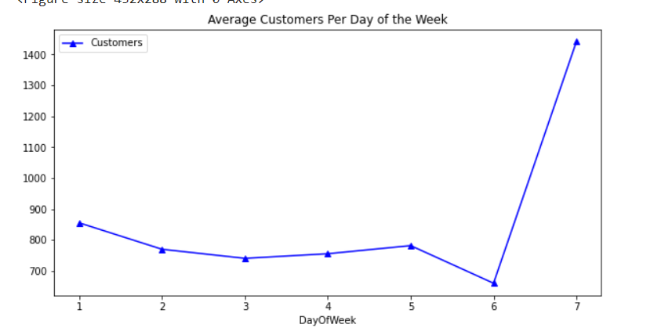
STEPS

Slide 23
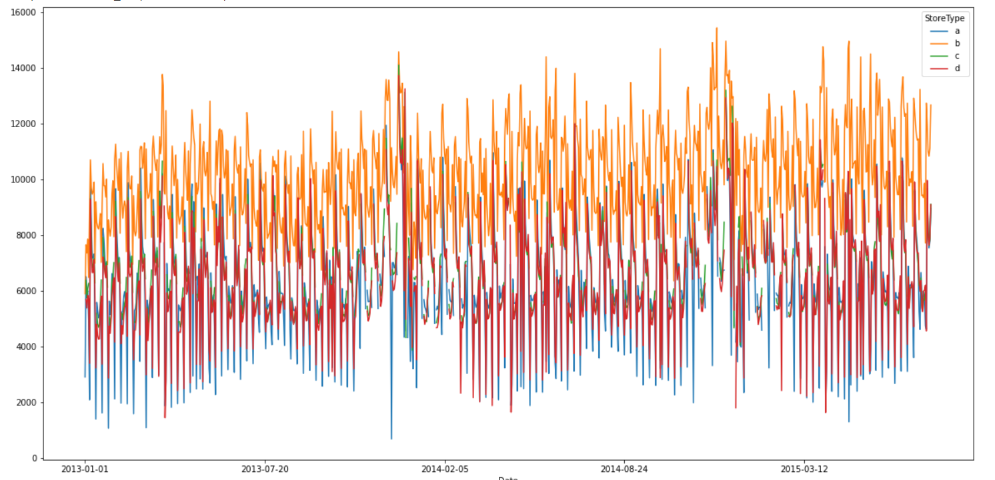
STEPS
Date and Store Type
fig, ax = plt.subplots(figsize=(20,10))
sales_train_all_df.groupby(['Date','StoreType']).mean()['Sales'].unstack().plot(ax=ax)

Slide 24
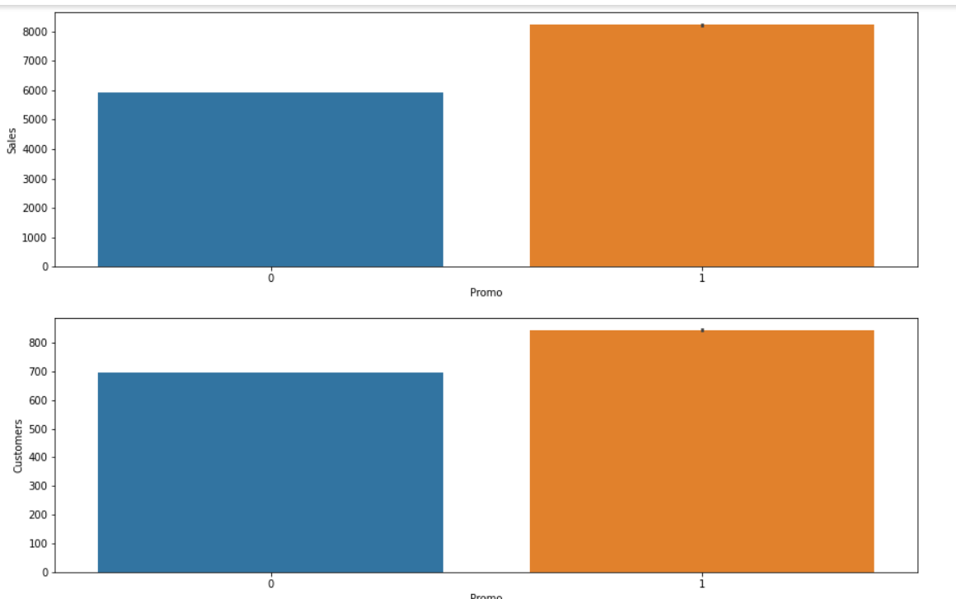
STEPS
Promo Sales and Promo Customer Charts

Slide 25
Expected Results
Projected Sales in 2016 and 2017 by Year
Projected Sales 2016 and 2017 month wise
Number of customers expected in 2016 and 2017 month wise
Sales with Promo 2016 and 2017 month wise
Top 10 Store by Sales 2016 and 2017
Bottom 10 Store by Sales 2016 and 2017

